Slide 1
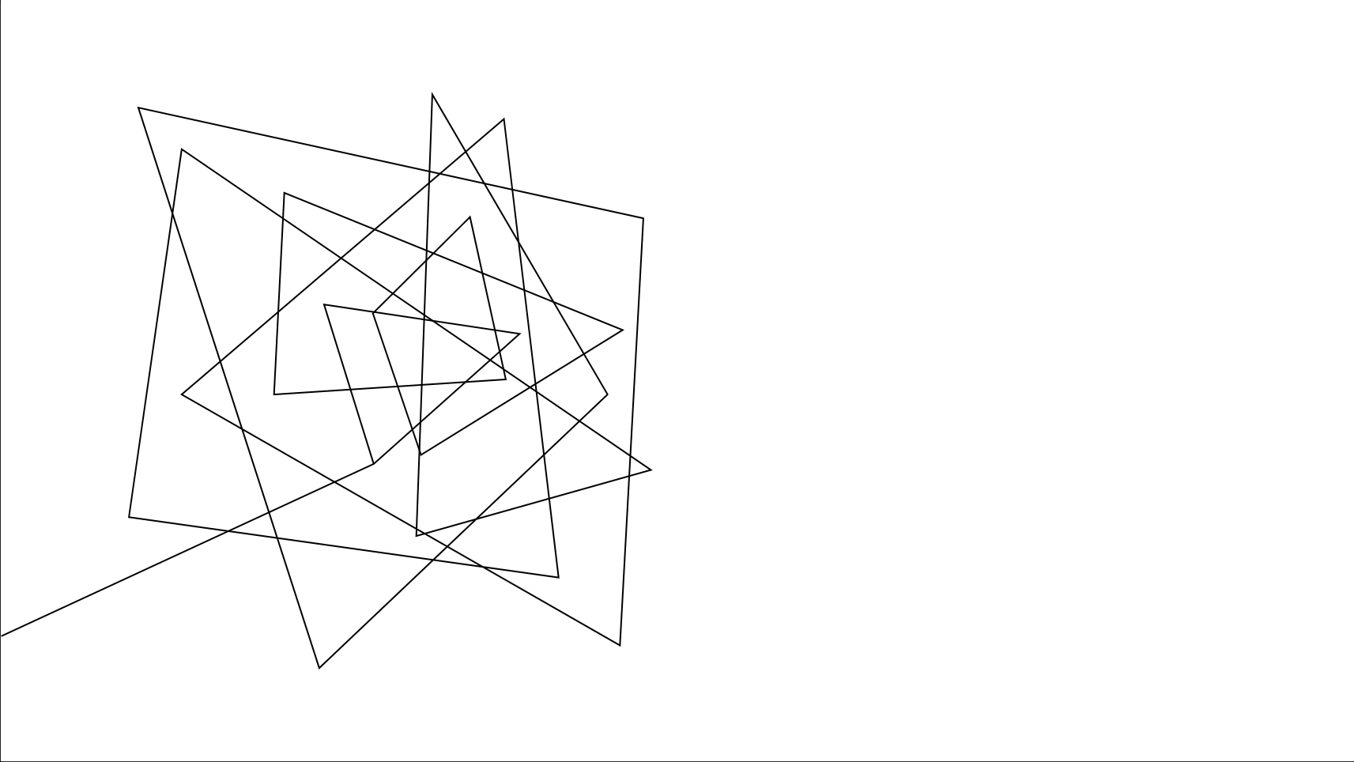
Dr. Pill
Automatic Pill Dispenser

Slide 2





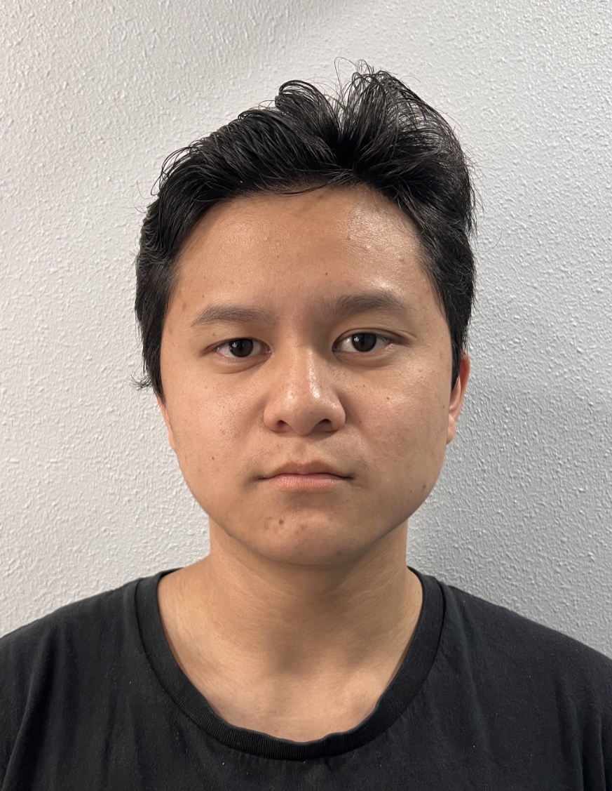
MEET THE TEAM
Jonathan Cerniaz
Jehmel
Espiritu
Jeremy Espiritu
Joseph Guzman
Afzal
Hakim
Lee Roger
Ordinario
Power Supply & Regulation
Circuit Design
Software Development of Interface
Software Development of Interface
System prototyping and calibration
3D Design
Log tracking and Security
Pill Storage System and Organization
Soldering

Slide 3
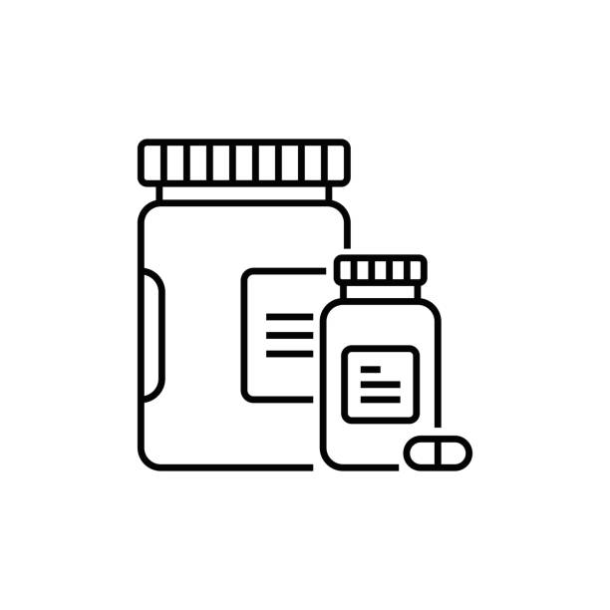
PROJECT OVERVIEW
"Our project consists of..."
Pill Dispensing
Touchscreen Display
Authenticators and Cloud Database
Dr. Pill

Slide 4
OUR 3 DEMOS
Dispense Mechanism & Storage​
Displaying User Interface​
Authentication & Security
Final: Dr. Pill The Automatic Pill Dispenser
Dr. Pill

Slide 5
Today's demo
Dispense Mechanism and Storage
Requirements: Drop system, storage compartments with funnel, 2 different pills minimum, correct amount of pills dropped
Constraints: Power Consumption, Motor Accuracy, Pill Dispensing Accuracy
Success: Correct pills and amount dispensed, motor efficiently moves, storage dispenses pills smoothly
Dr. Pill

Slide 6
DEMO TIME

Slide 7
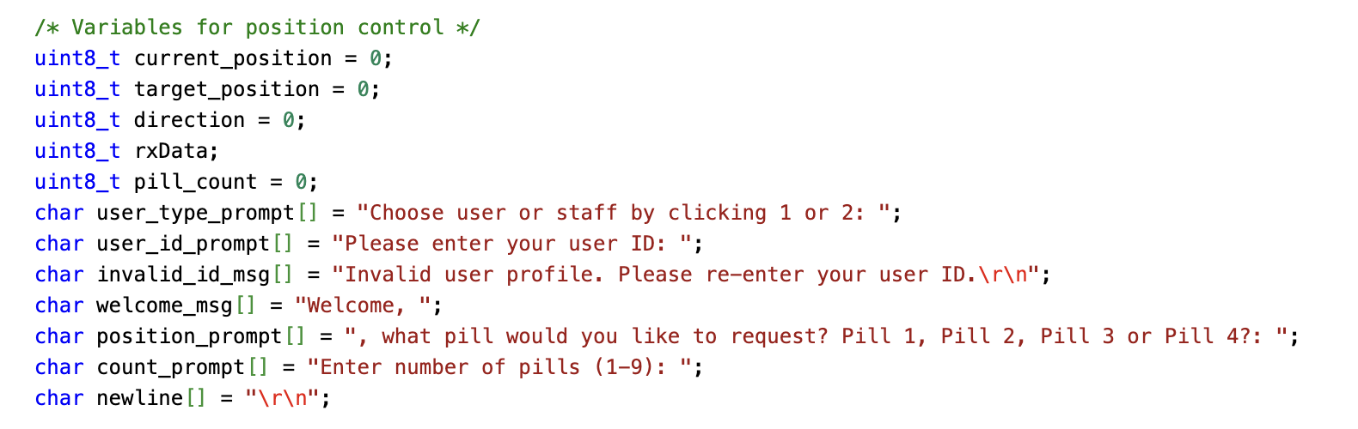
Technical details
Dr. Pill

Slide 8
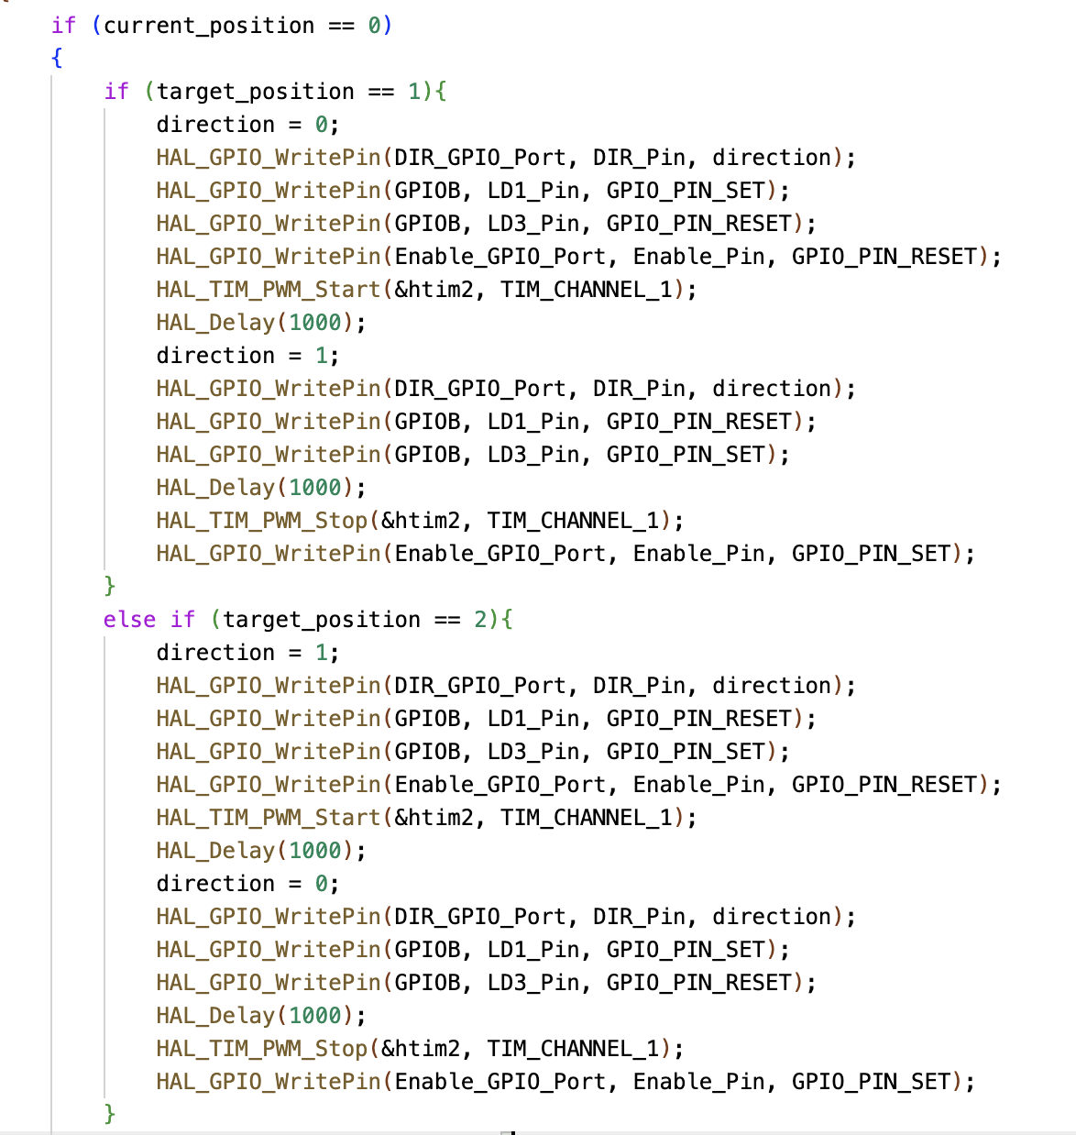
Technical details
Code snippets
Dr. Pill

Slide 9
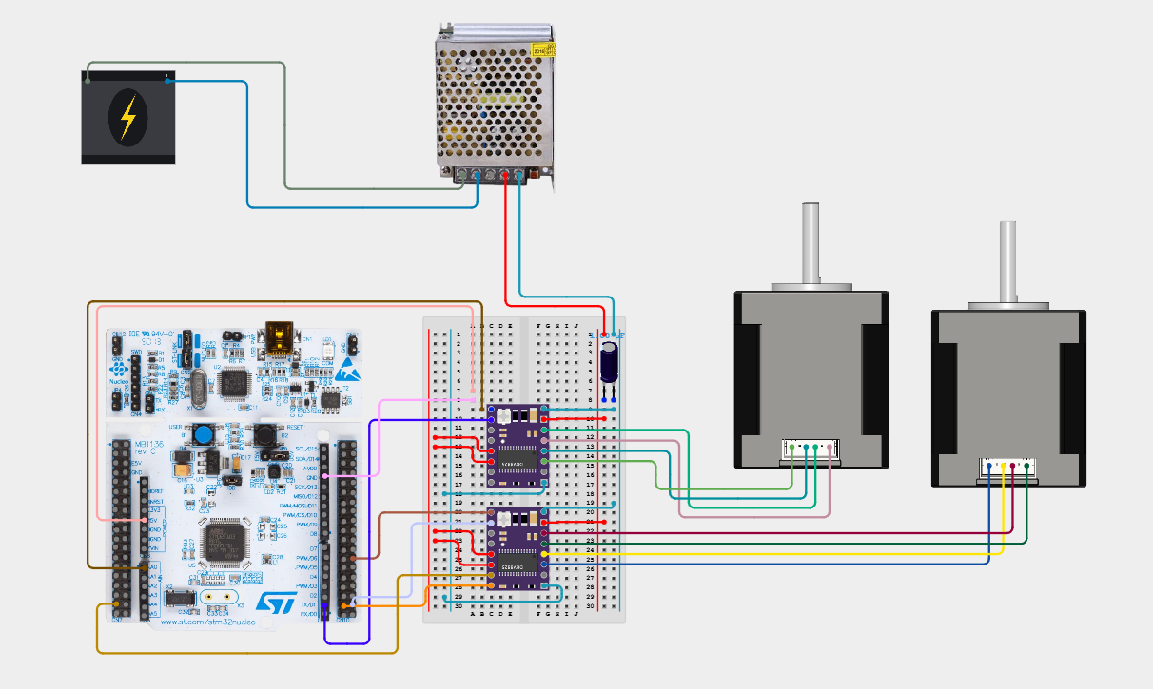
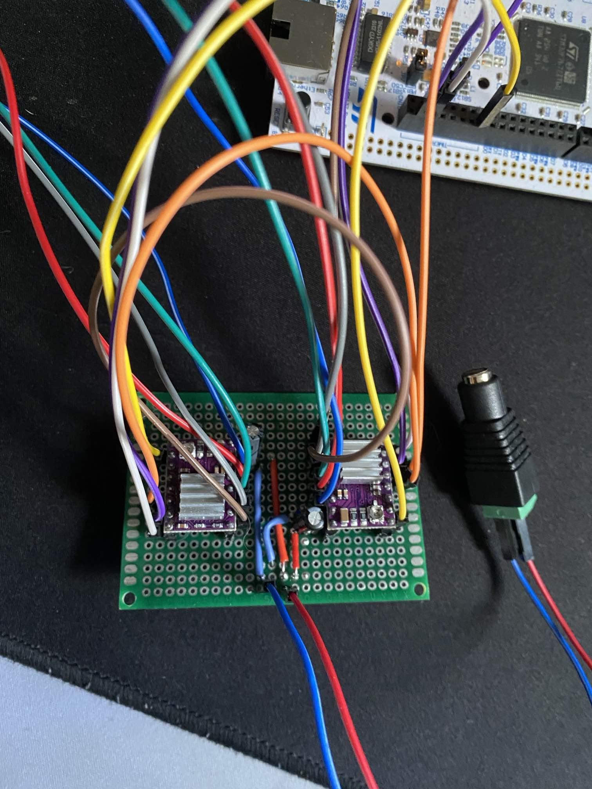
Technical details
Dr. Pill

Slide 10
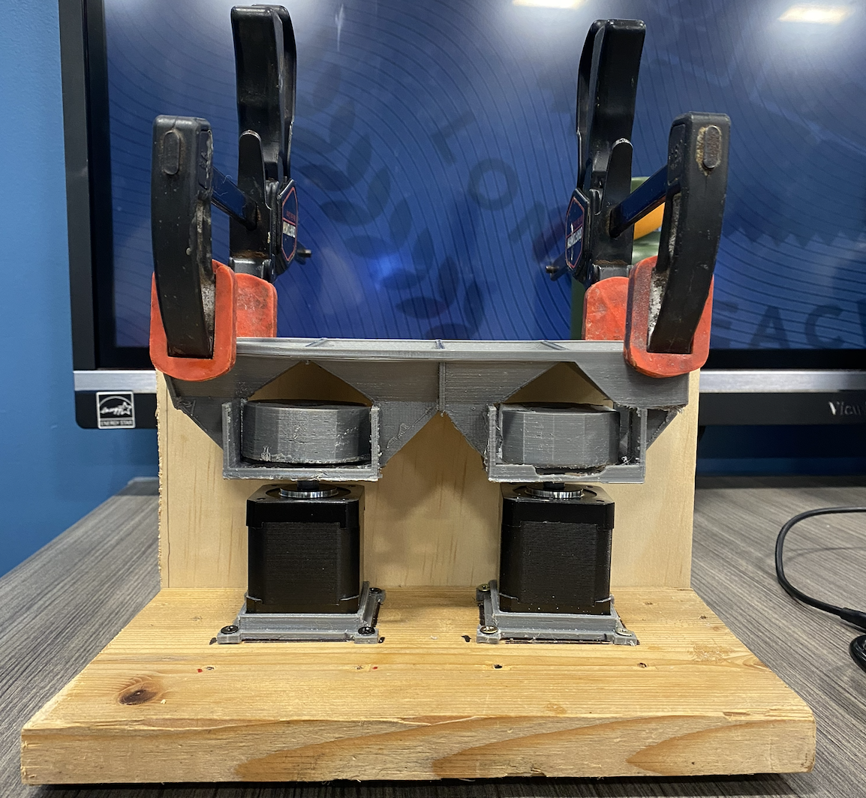
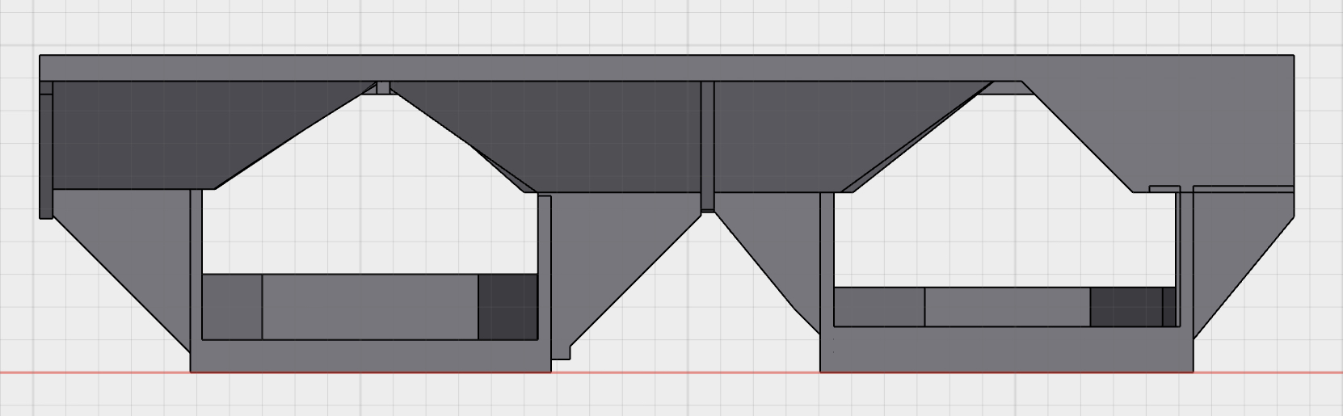
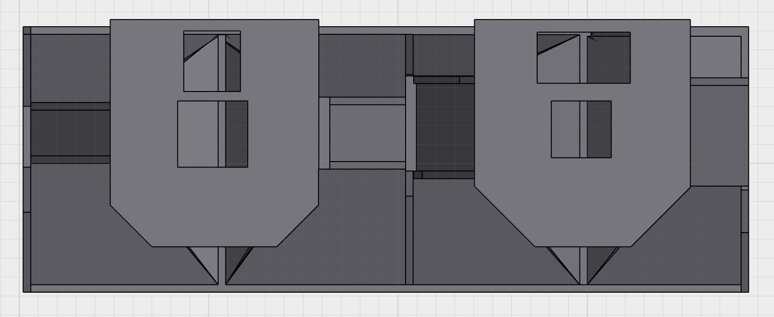
Technical details
Dr. Pill

Slide 11
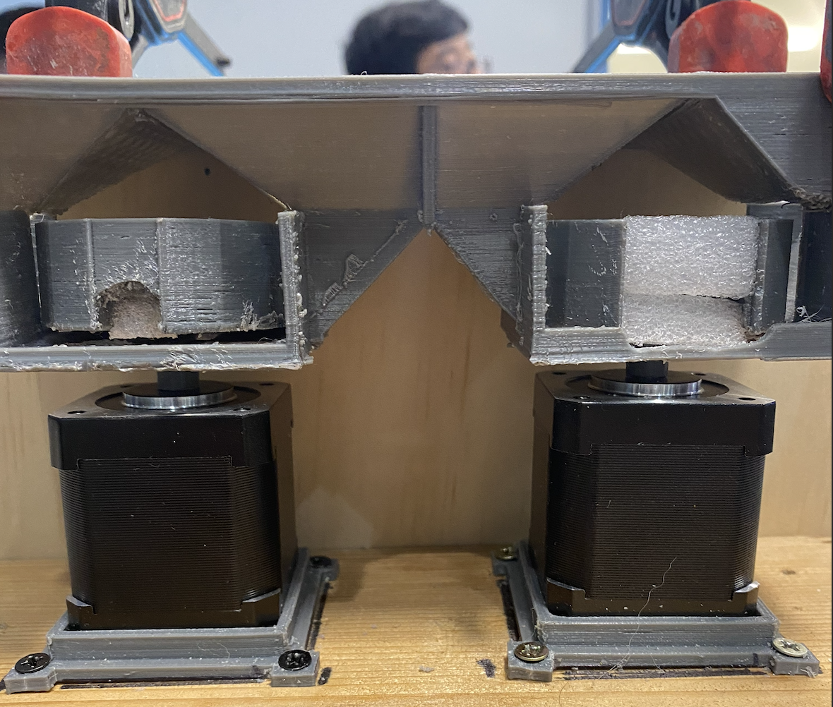
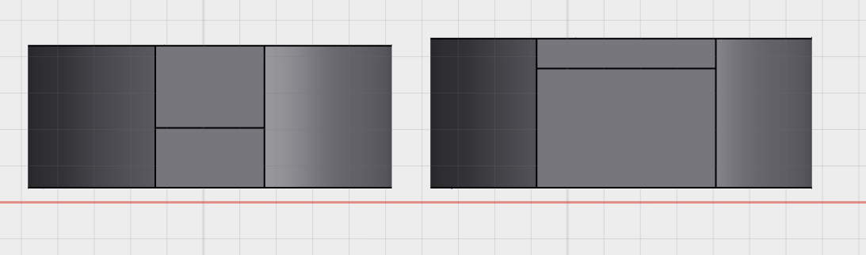
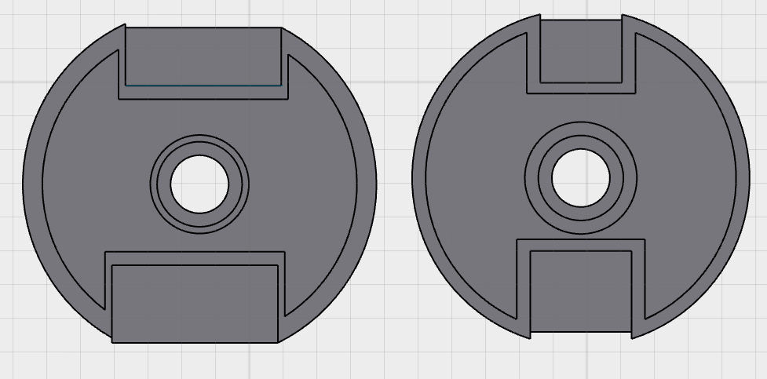
Technical details
Dr. Pill

Slide 12
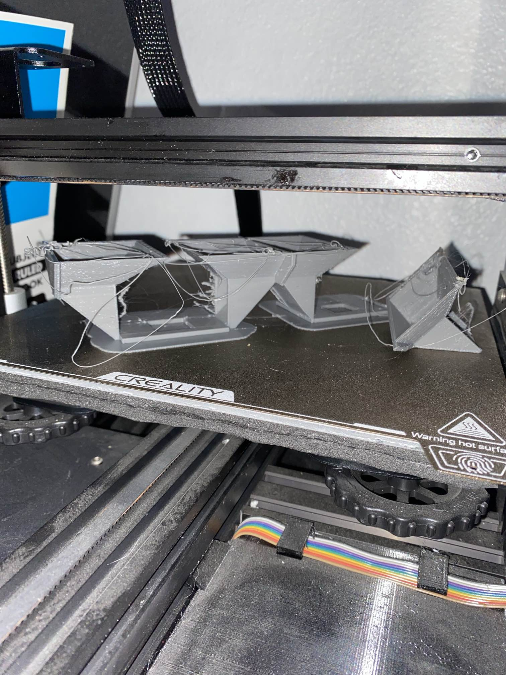
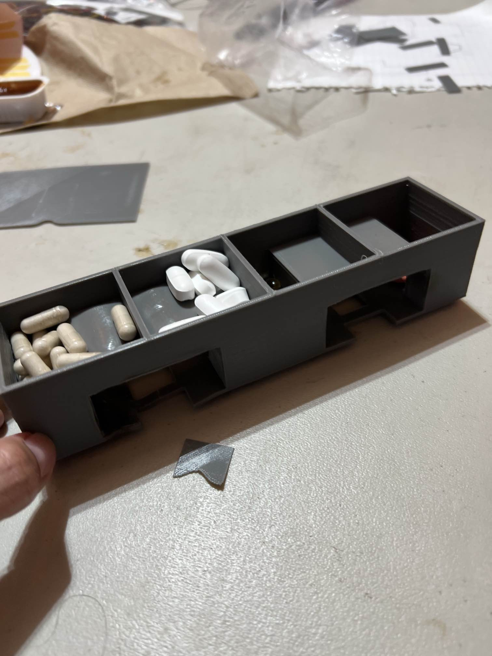
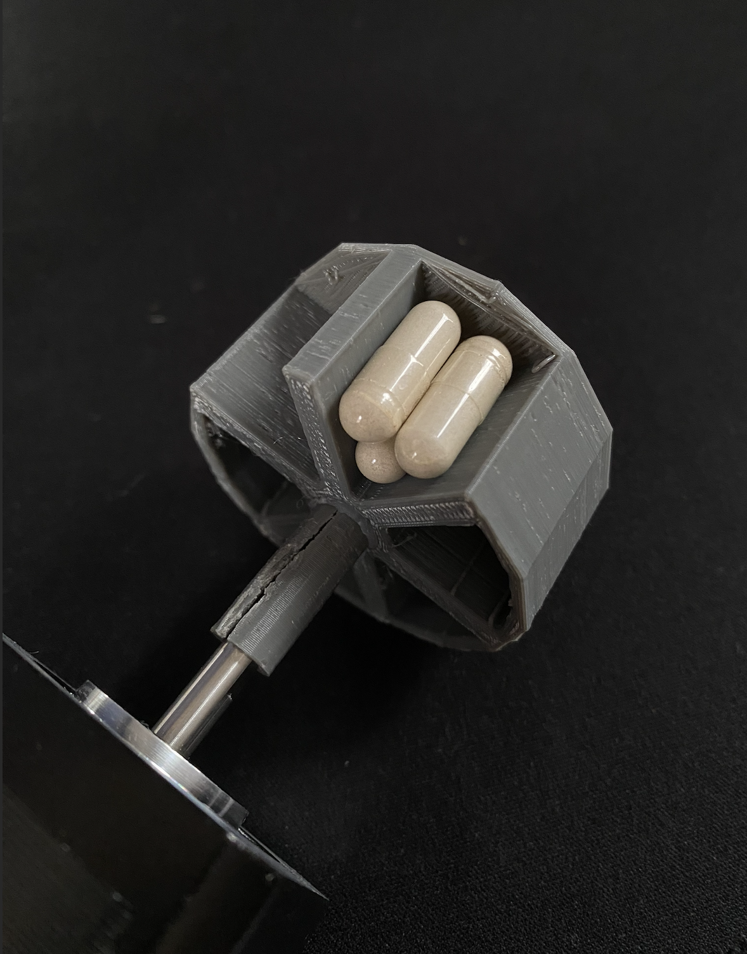
challenges
Printing time Pocket refill Printing Dimensions
Dr. Pill

Slide 13
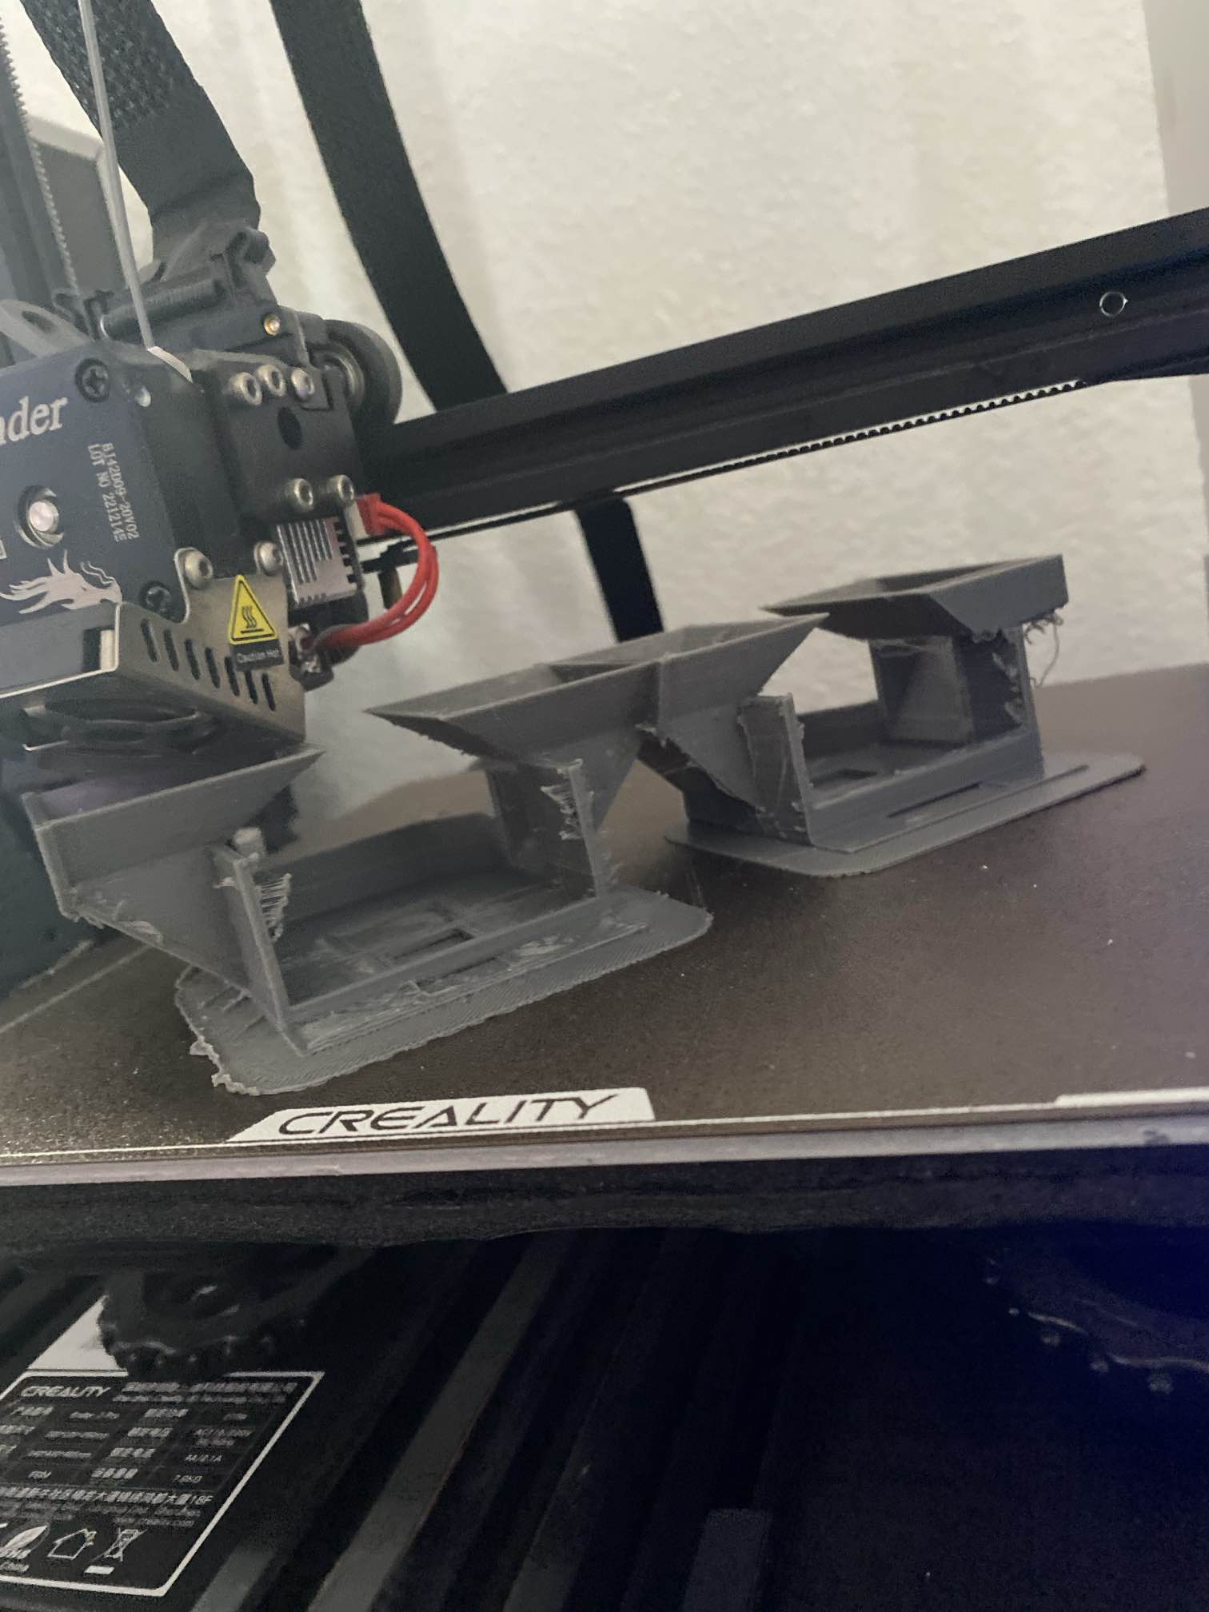
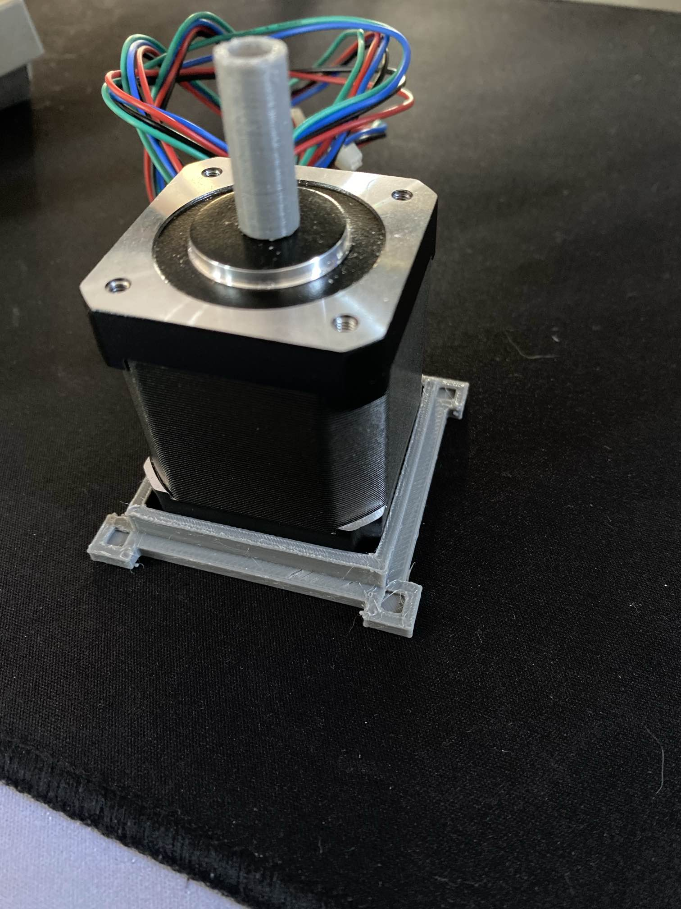
Overcoming challenges
Printing Time
Redesign pocket and storage to lower material and time required without compromising the stability of the design. Simplifying the design, making it easier to recreate/expand on for later demos.
Pocket refill
So we don’t have to reprint too many times, we decided to have the funnel and pocket be open to customize based on the pill we will test. Pockets will be replaceable depending on the pill.
Dr. Pill

Slide 14
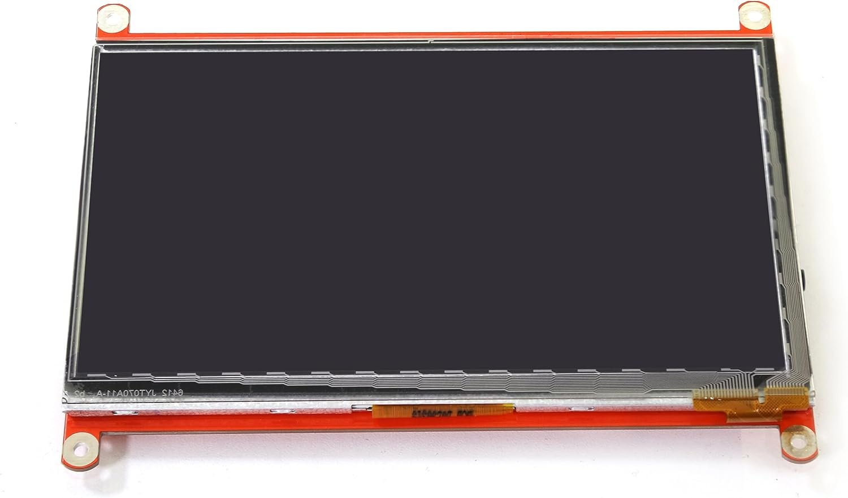
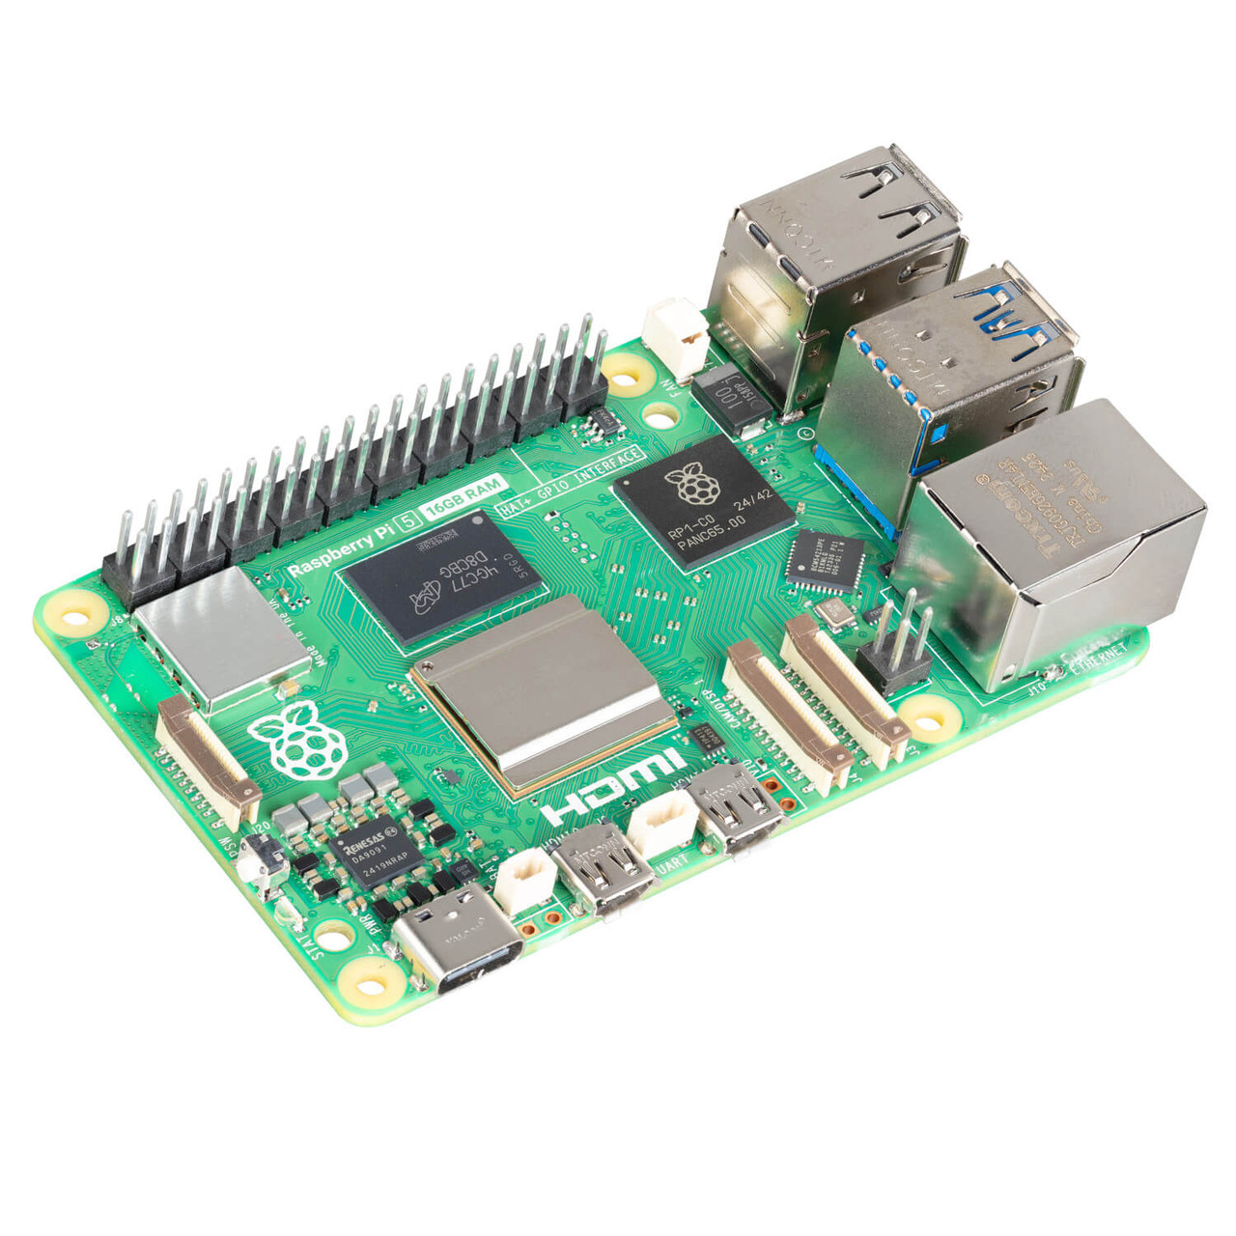
NeXT demo
DISPLAYING USER INTERFACE
Requirements: Touchscreen LCD Display, Raspberry Pi 5
Success: Responds accurately and consistently, Terminal displays correctly on the LCD
Dr. Pill

Slide 15

Thank You
Dr. Pill

